Slide 1
Triangular Arbitrary
CSC 436
Group 6
Milestone 1

Slide 2
Team members
Mitchell Ergen
Eric Haerr
Kevin Lineback
Kevin Looft
Tyler Reed

Slide 3
Overview
As a stock and cryptocurrency tracking application, The Triangular Arbitrary web app will allow users a simple and focused method for monitoring their investments.
Users are able to choose their favorite stocks and see real-time values. They can also see the value of their favorite cryptocurrencies.
System admins are available 24/7 to provide support for account management as well as monitoring for fraudulent activities.

Slide 4
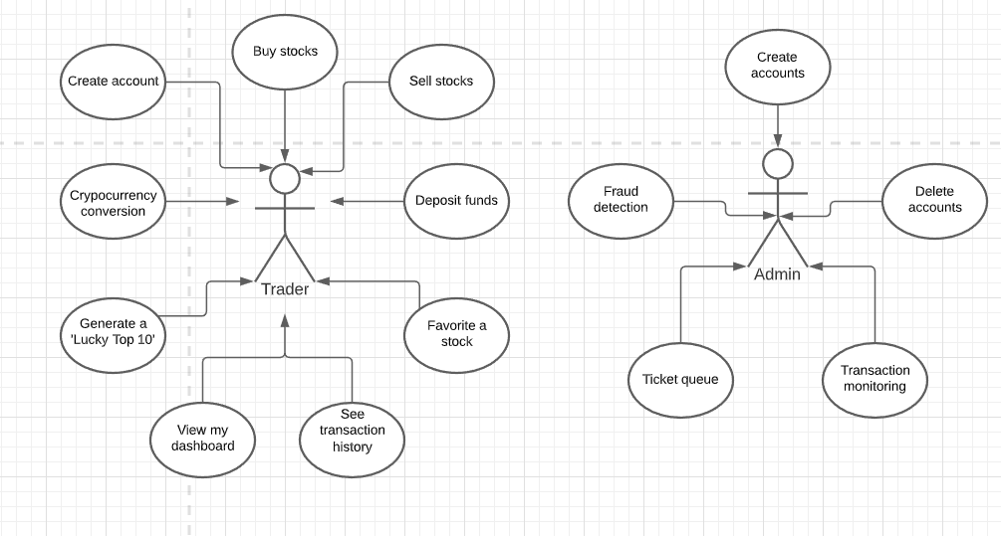
Requirements: Use cases

Slide 5
Persona 1: Danny “Day Trade” Hughes
Danny is a thirty-two-year-old male.
He lives with his fiancé in an apartment in Chicago.
Danny holds an undergraduate degree in Finance and a Master of Business Administration degree.
He works for a FinTech company.
After work, Danny spends time at home with his fiancé.
On the weekend, Danny prefers to go out with friends.
Danny and his fiancé want to save money for a down payment on a house in the suburbs.

Slide 6
Persona 1: Danny “Day Trade” Hughes
In order to help save money, Danny has turned to day trading on the stock market.
He is familiar with trading basics from his degree and his job.
Danny primarily trades in between meetings and on his morning, afternoon, and lunch breaks at work.
He has invested in a small number of volatile stocks that he plans to sell when the share price increases.
Additionally, he has invested in a few cryptocurrencies.
Danny needs a way to track the stocks and cryptocurrencies he has invested in.
Danny spent time looking for a webapp that will suit his needs.

Slide 7
Persona 1: Danny “Day Trade” Hughes
He comes across a webapp called Triangular Arbitrary.
Danny creates an account and sets his preferences.
He searches for some of his current investments and adds them to his favorites.
He now has an easy method of tracking his stock and cryptocurrencies.
He also frequently reviews the I’m Feeling Lucky Top 10 list for new potential investments.
Danny is now able to make faster decisions regarding when it is time to buy and sell his investments.

Slide 8
Persona 2: Adam the Admin
Adam is the administrator for our application; he is a jack of all trades when it comes to system administration.
He works from home and is responsible for the upkeep, configuration, and reliable operation of the system.
Apart from overall system monitoring, Adam spends most of his time helping customers reset their accounts after being locked out from entering too many incorrect passwords.
He monitors and takes actions upon support tickets from end users.
On occasion, Adam will have to take the system down at 4 AM to perform patching or updates.
Adam is also in charge of security and monitors for fraudulent accounts and other potential threats to the system.

Slide 9
External service integration
Alpha Vantage
Firebase
Google Analytics
BootstrapCDN

Slide 10
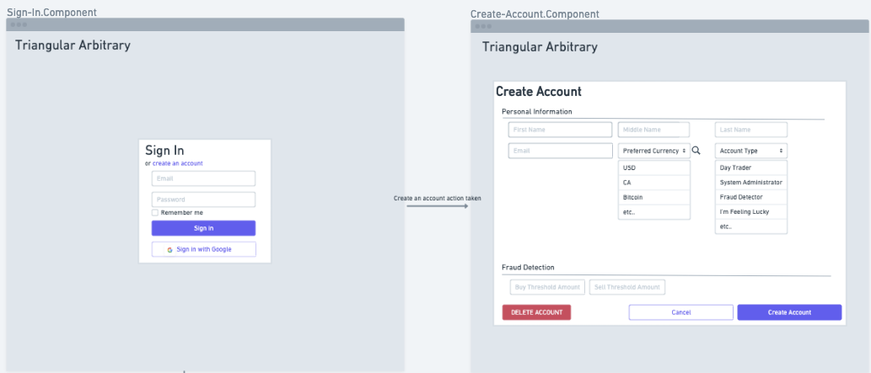
Screen Flow

Slide 11
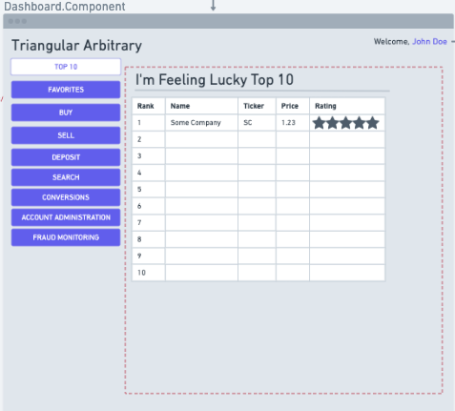
Screen Flow

Slide 12
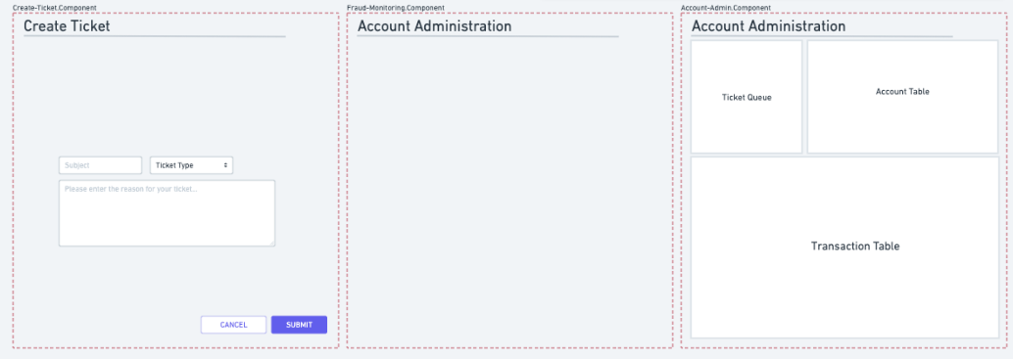
Screen Flow

Slide 13
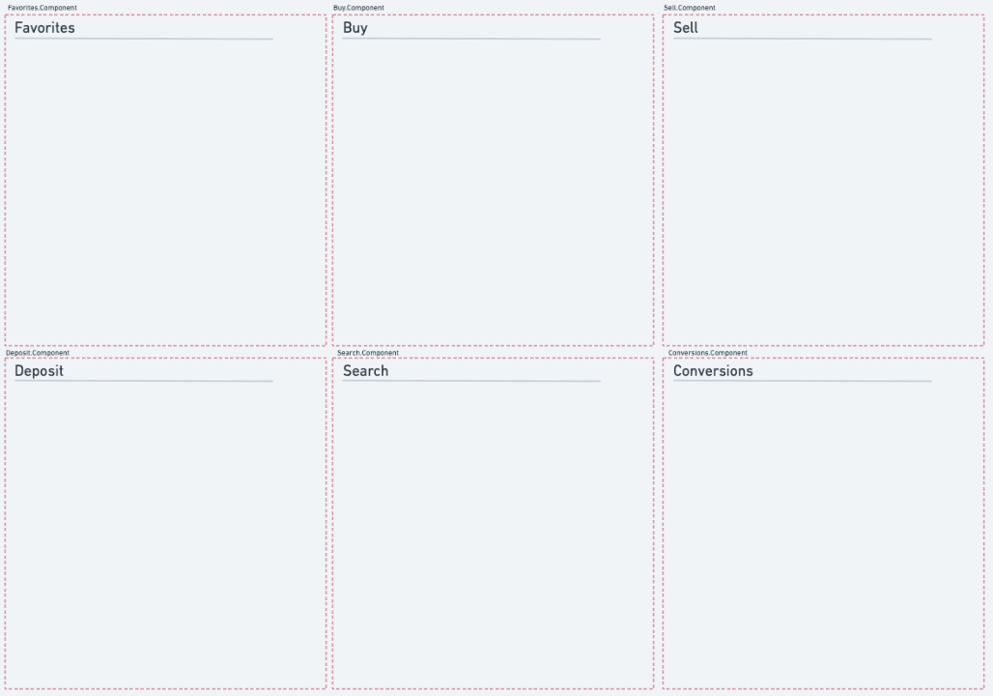
Screen Flow

Slide 14
Challenges
Medical Services Application
BetterDoctor API
Scope of the Application

Slide 15
Current Scope: User
Login
Navigation
Create Account / My Account
Create Ticket
Favorites
Search
Top 10
Conversions

Slide 16
Current Scope: Admin
Account Administration
Manage Ticket Queue
Manage Accounts

